Slide 1
ECE 447 Beyond Linear Control and Machine Learning
Spring 2019
Prof. Eric Klavins

Slide 2
This Course
+
u
Linear
System
r
y
-
^
Linear Controller
^
Linear Estimator
K x
x
Plant is assumed linear (or linearized)
Plant is well understood
Goal is to track r
No randomness or substantial noise

Slide 3
Next Courses
ECE 448: Control systems lab with hardware
ECE 449: Control systems capstone
Graduate courses
547: Advanced linear control systems
548: Linear multi-input / multi-output
549: State estimation and system identification
550: Optimal control (e.g. use the least energy)
552: Power systems control
570: Geometric control (e.g. robots, vehicles, manipulators)
582: Digital control
583: Nonlinear control
585: Adaptive control (i.e. when the plant dynamics are drifting over time)
593: Feedforward control
594: Robust control (i.e. robust to disturbances, noise and uncertainty)
597: Network control (e.g. control of swarms of robots)
Still linear
control systems

Slide 4
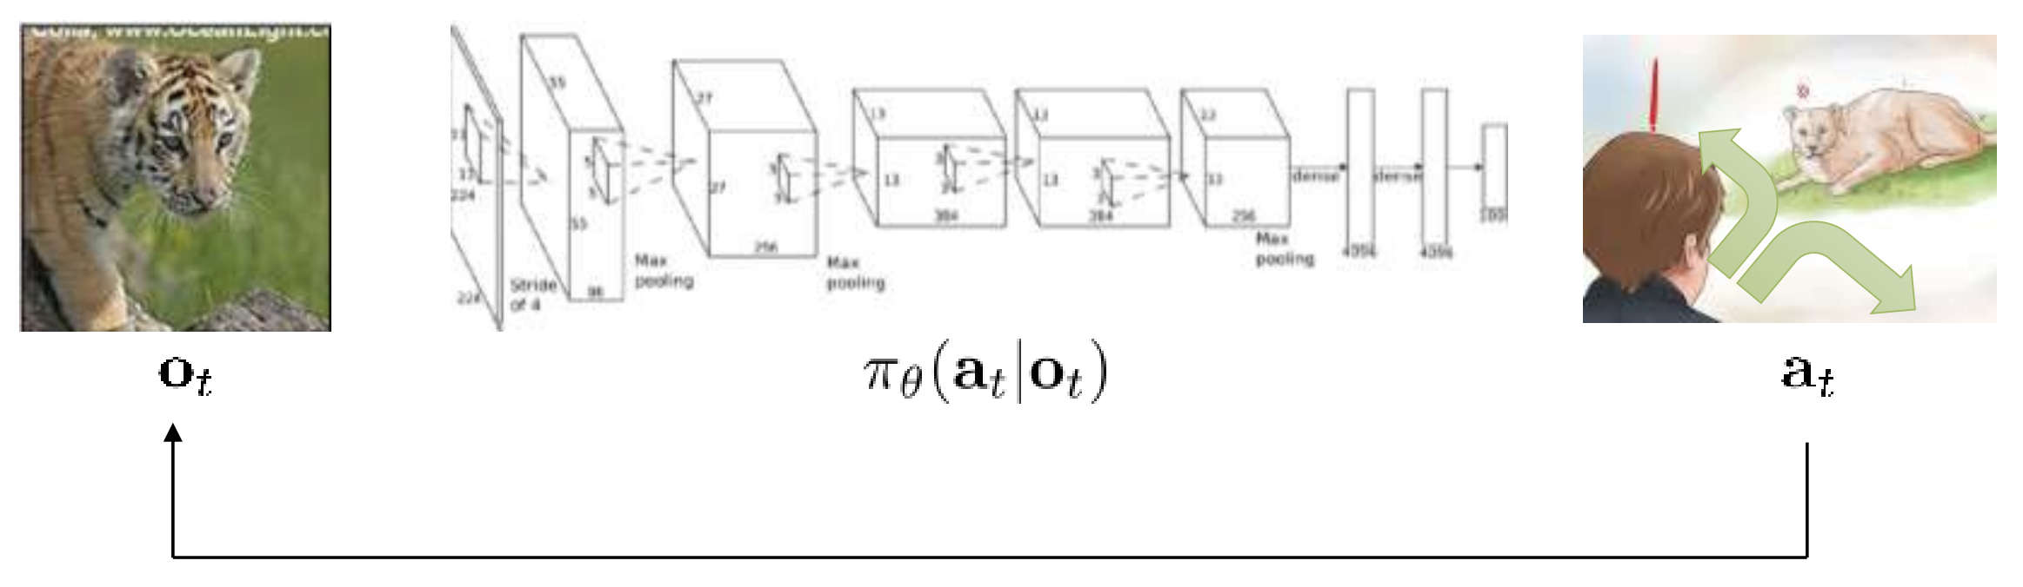
Machine Learning
Often applied to classification problems
Tiger?
Puppy?
Fish?
…
f_{𝜽}(image) = species
Goal: find parameters 𝜽 to minimize number of misclassifications
Reinforcement Learning
Can be adapted to decision making and control
Goal: find parameters 𝜽 to maximize expected reward

Slide 5
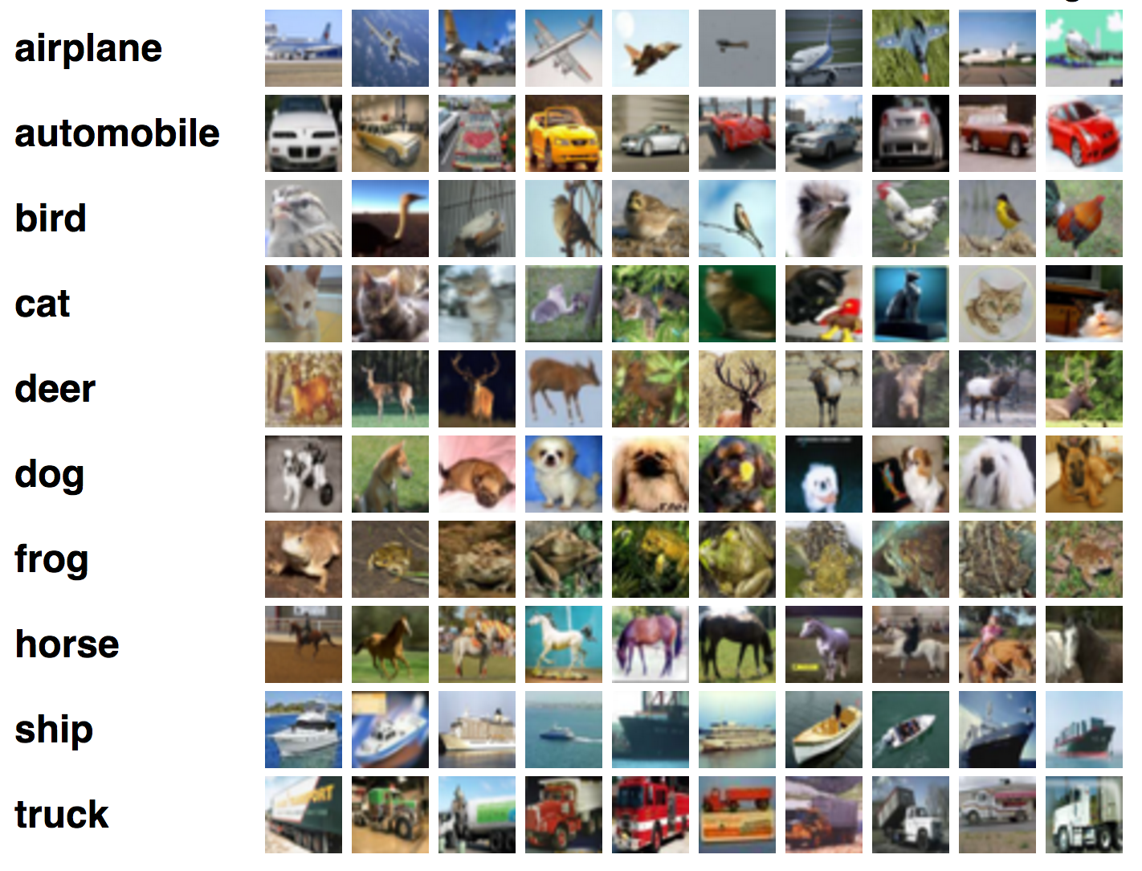
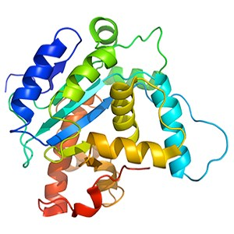
Classification Examples
Image classification
Protein stability
Takes labeled examples in.
Needs millions of images.
Once trained, is very good!
Takes amino acid sequence
Predicts stability of the resulting protein
Trained on experimental data
Can use to predict stability of new proteins
https://www.ncbi.nlm.nih.gov/pubmed/28706065

Slide 6
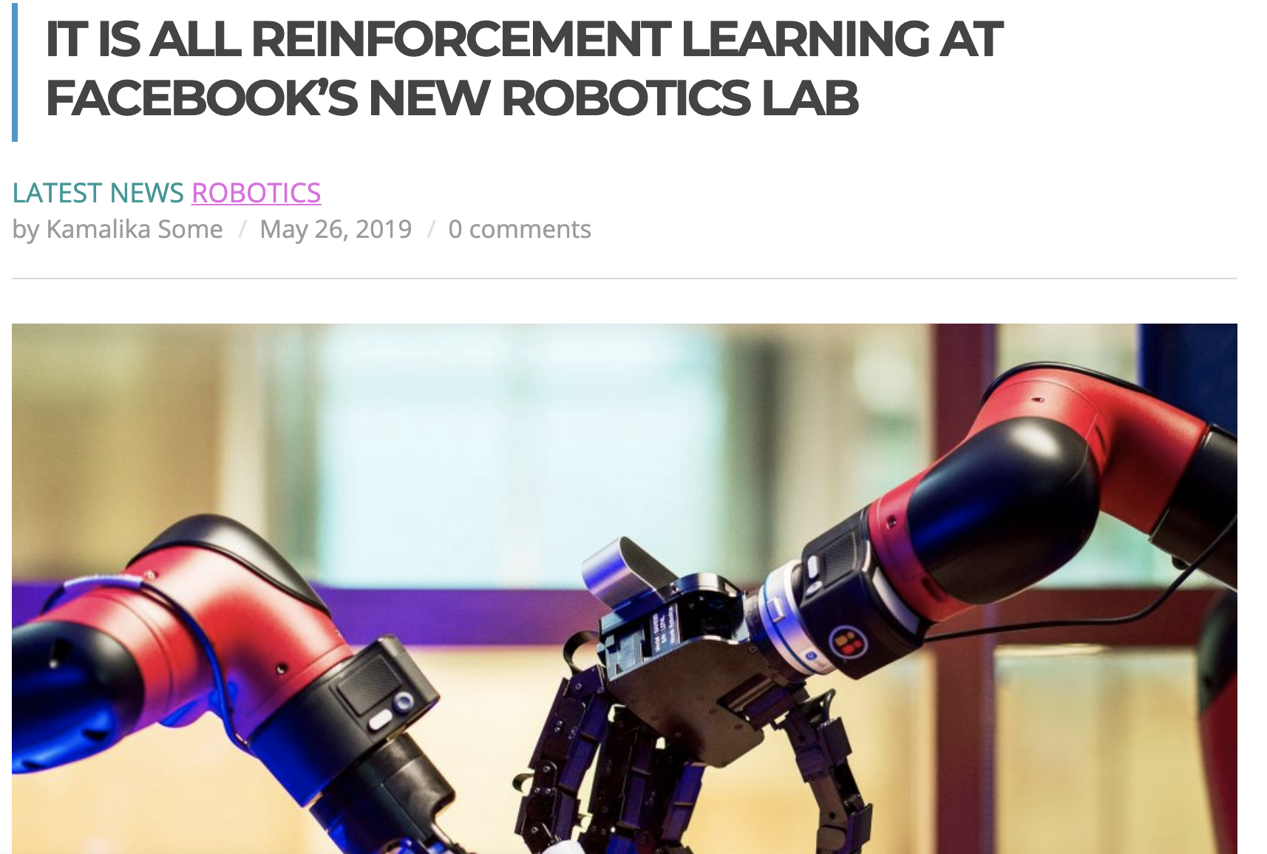
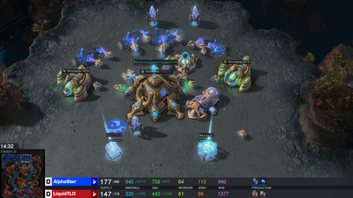
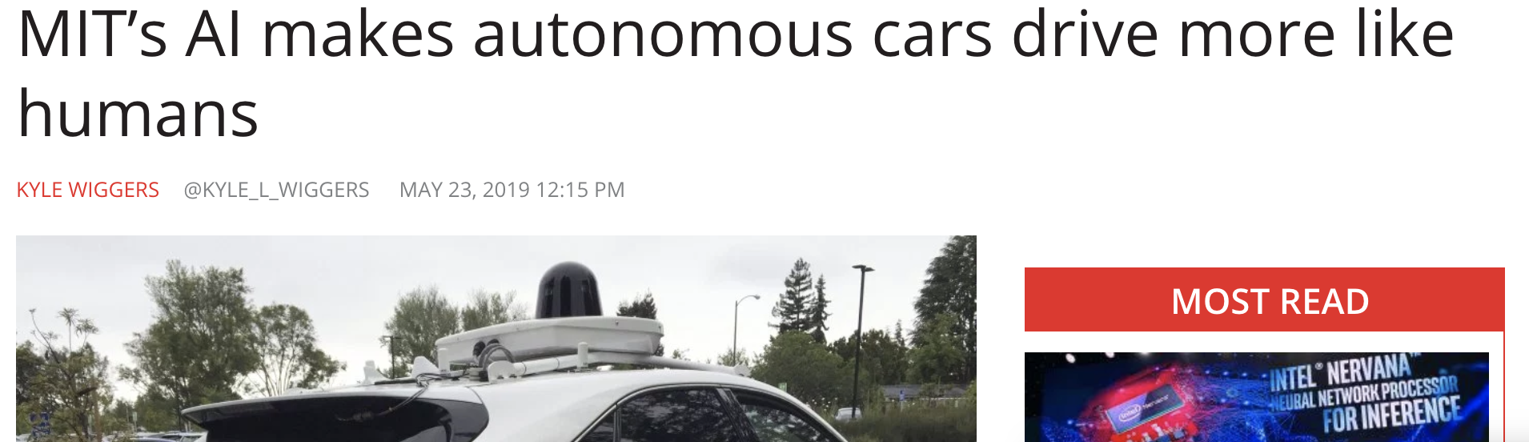
Examples of Reinforcement Learning
AlphaStar: Mastering the Real-Time Strategy Game StarCraft II

Slide 7
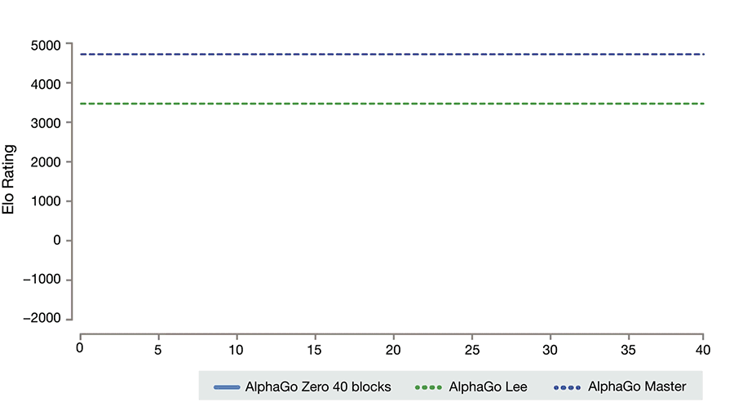
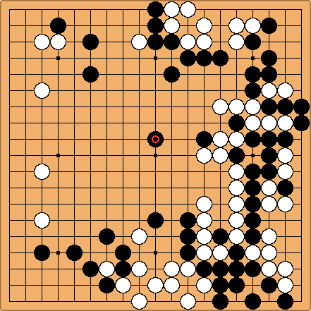
Alpha Go: Deep Q-Learning
https://deepmind.com/blog/alphago-zero-learning-scratch/

Slide 8
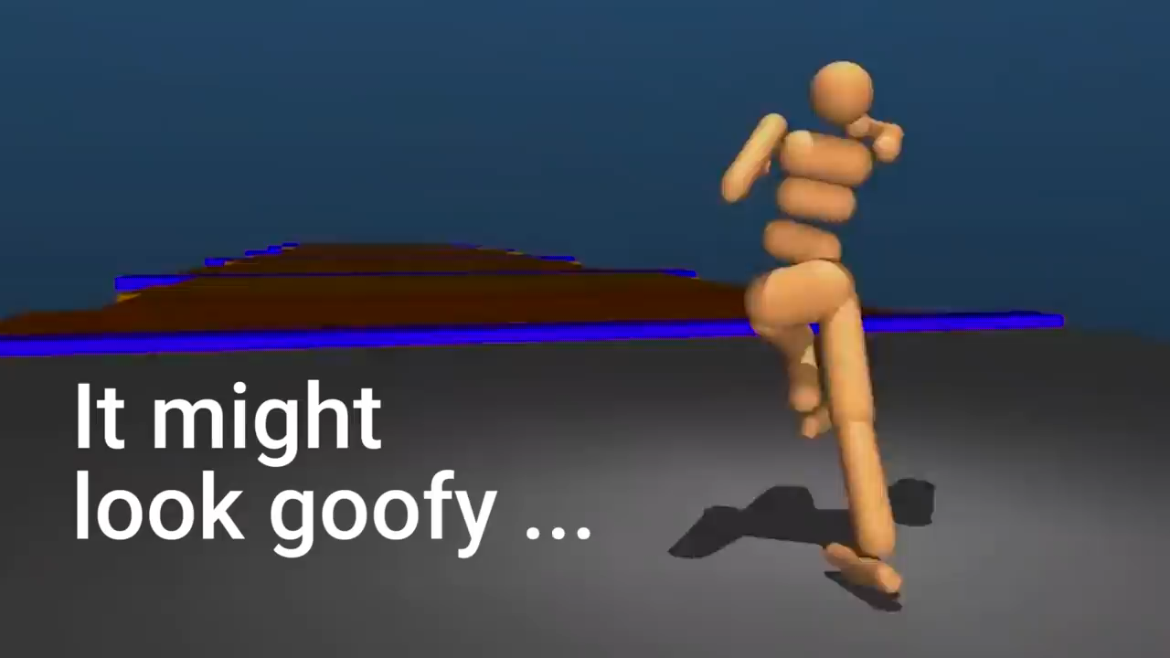
Physically realistic robot running

Slide 9
Outline
Reinforcement learning
http://rail.eecs.berkeley.edu/deeprlcourse-fa17/index.html#lectures
Neural networks
Q-learning (Reinforcement learning with neural networks)

Slide 10

States, Actions and Rewards
Examples:
Video game: Action = move or fire, reward = score
Walking: Action = apply torque to joins, reward = distance traveled
Controls tasks: Action = input u_{t} ,reward = 1 / error.
Chess: Action = move a piece, reward = 1 if action results in a win, 0 otherwise

Slide 11
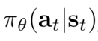
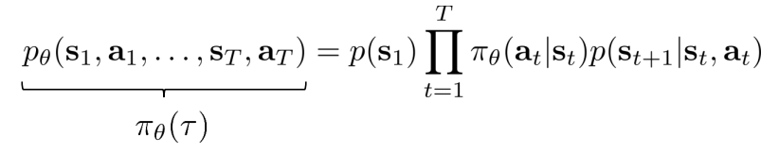
Policies
A policy is a parameterized probability distribution that says what to do in a given state, and is written
Parameter vector
State at step t
Action to take at step t
Trajectories result from policies and the environment:
Probability of new state given
the old state and an action

Slide 12
Example: Goals and obstacles
States: (x,y) location
Rewards: -1, 0, or 10 depending on state
Action: up, down, right, left
Environment: Moves the requested direction unless at an edge
Policies: probability of going up, down, right, or left in each state.
=> A policy has 4 x width x height parameters (100 in this case)
Example trajectory: (0,0), up, (0,1), up, (0,2) up, (0,3), down, (0,2), right, (1,2), down, …

Slide 13
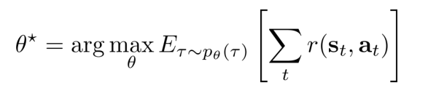
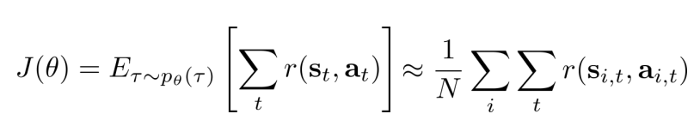
Reinforcement Learning Goal
J(𝜽)
Find 𝜽 so that the expected sum of rewards over all trajectories is maximized.
Approximation: Just run policy π_{𝜽} a bunch of times to estimate the average reward.
Sum over sample trajectories produced by π_{𝜽}.

Slide 14
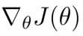
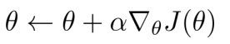
Maximizing J(𝜽) Using Gradient Assent
J(𝜽)
𝜽
Learning rate

Slide 15
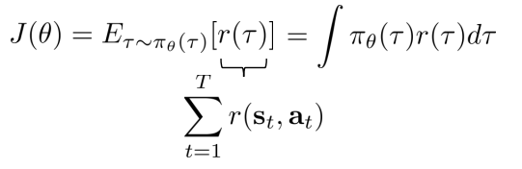
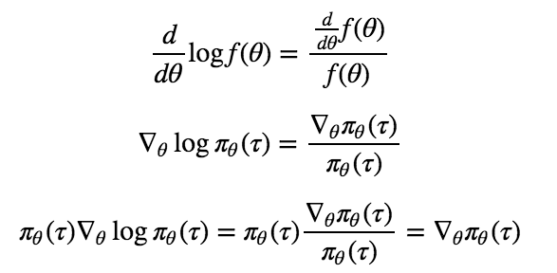
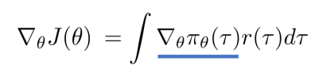
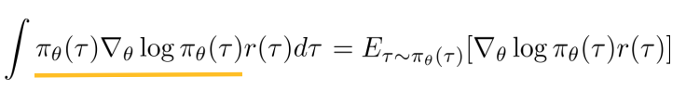
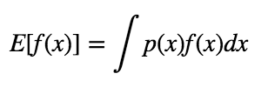
Approximating

Slide 16
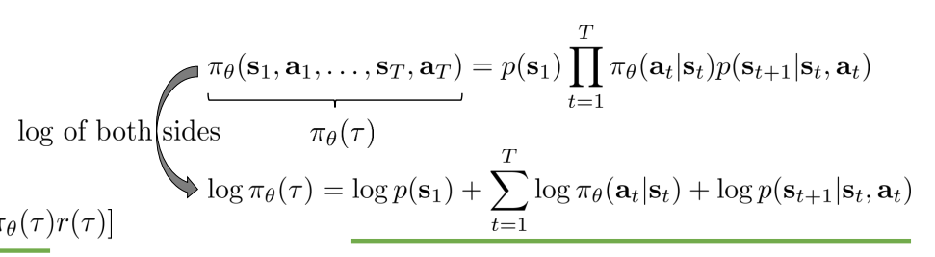
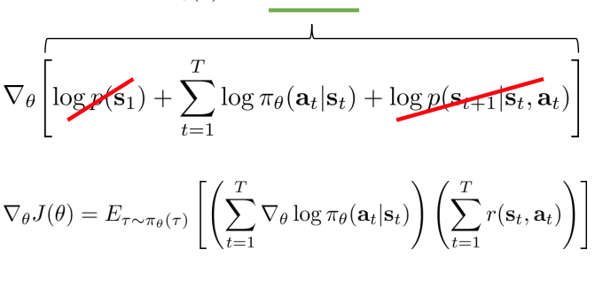
Approximating

Slide 17
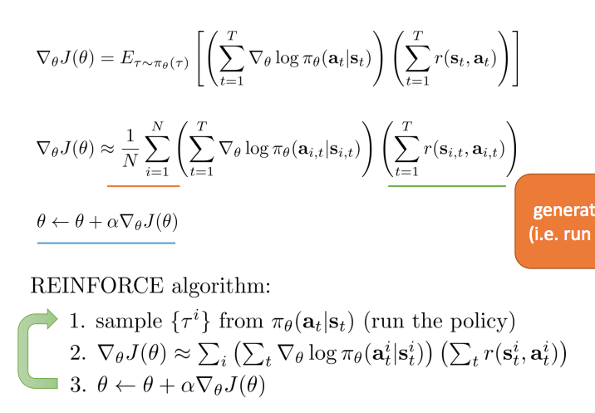
The REINFORCE Algorithm

Slide 18
Example
Go to reinforce-map.ipynb
Questions:
Given that trajectories are length 15, what is the maximum reward a trajectory could get?
What happens when you increase the learning rate?
What happens when you decrease the number of samples per epoch?
Can you change the map to get it stuck in a local minima?

Slide 19
Simple control example
x’ = 1.1 x + u
Discretize state
For each discretized state q, choose a u according to a normal distribution N(m_{q},v_{q})
The parameters are then m_{q},v_{q} for q in the set of discretized states

Slide 20
Limitations of REINFORCE
This term is called the “cost to go”.
Only a sample of a reward for a single trajectory.
What if we could come up with a model of the cost to go that was more accurate and remembered past trials?
r₃
r₂
r₁
r₄
r₅

Slide 21
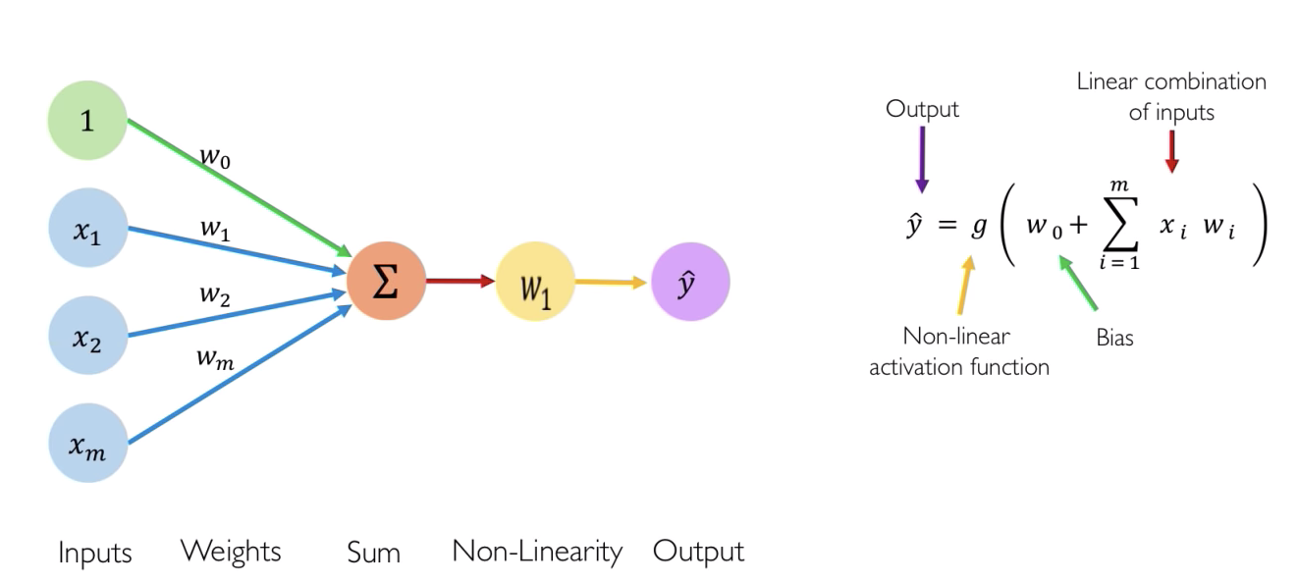
Neural Networks

Slide 22
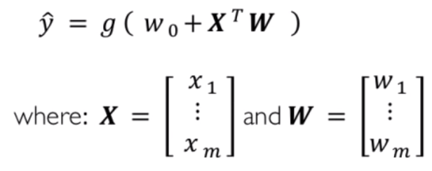
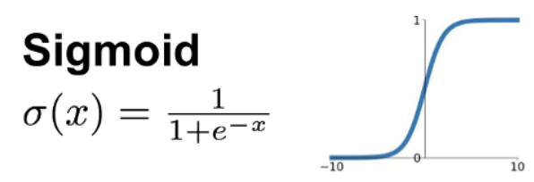
Neural Networks
Activation Function:

Slide 23

Common Activation Functions

Slide 24
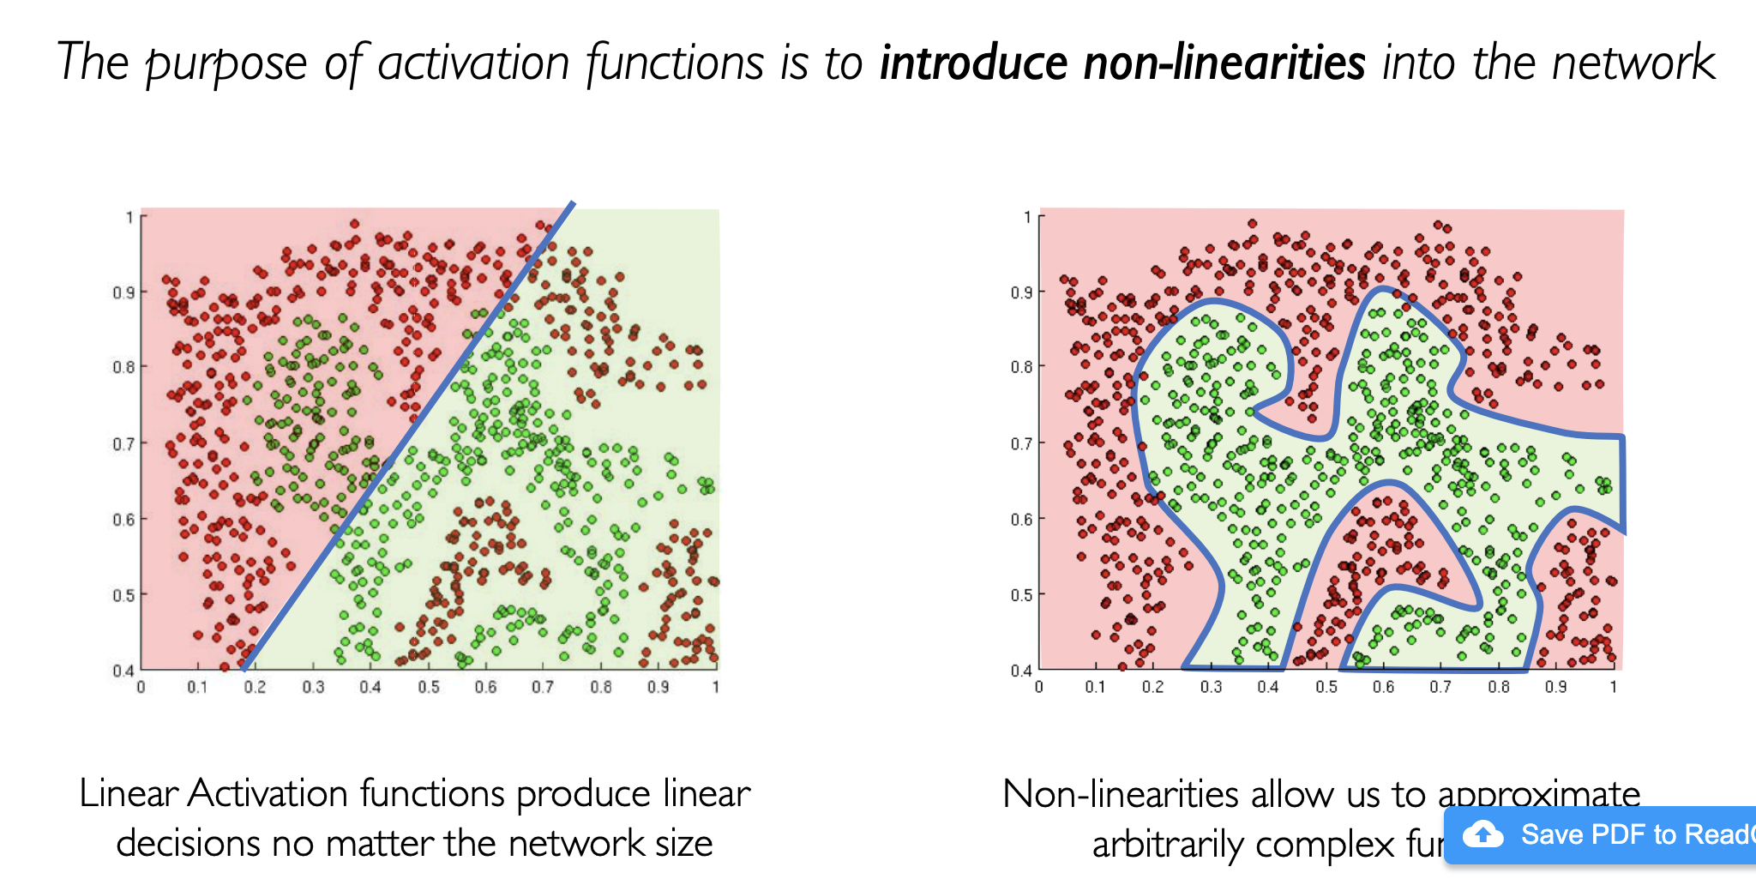
Non-linearities

Slide 25
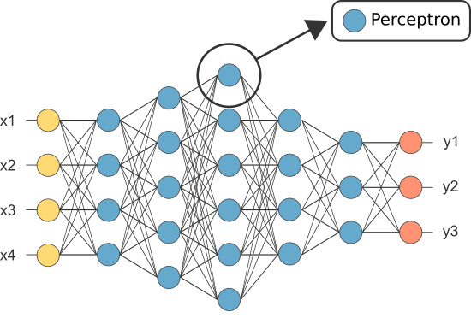
Multiple Layers
E.g. State, action pairs
E.g. Rewards
Perceptron
The above is just a function that takes four inputs and produces four outputs.
Usually the weights are initialized randomly and have to be tuned to get the function you want.

Slide 26
In Python
model = tf.keras.Sequential([
tf.keras.layers.Dense(5, activation=tf.nn.relu, input_shape=(1,)),
tf.keras.layers.Dense(10, activation=tf.nn.relu),
tf.keras.layers.Dense(2)])
x = tf.constant(np.transpose([np.linspace(-1,1,1000)]))
y = model(x)
plt.plot(x,y);
Model outputs
Model input

Slide 27
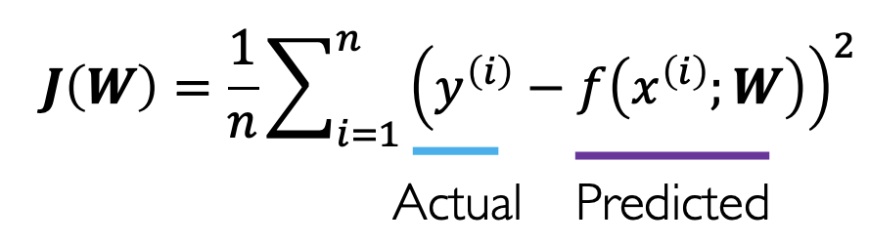
Evaluating Performance
f(x)
y
[1, 0, 0]
[0, 1, 0]
[1, 0, 0]
[0, 0, 1]
[0, 0, 1]
…
201
18
1
2
50
…
101
13
43
23
542
…
X =
Lots of other definitions for J can be used instead.

Slide 28
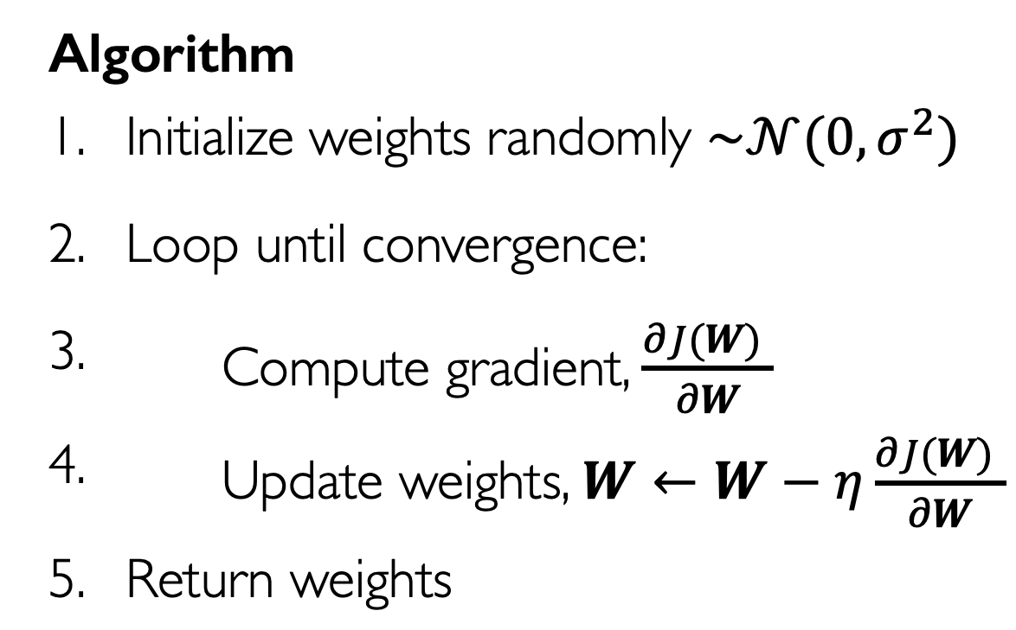
Gradient Descent (Again)
There is a sweet algorithm for doing this efficiently if the network has no cycles.
Its called Back Propagation.

Slide 29
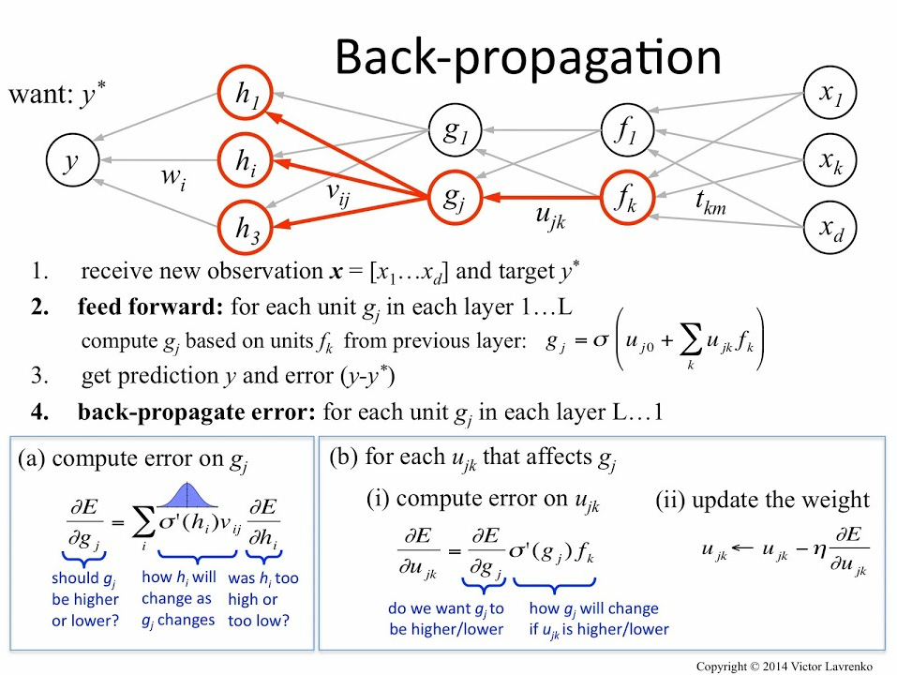

Slide 30
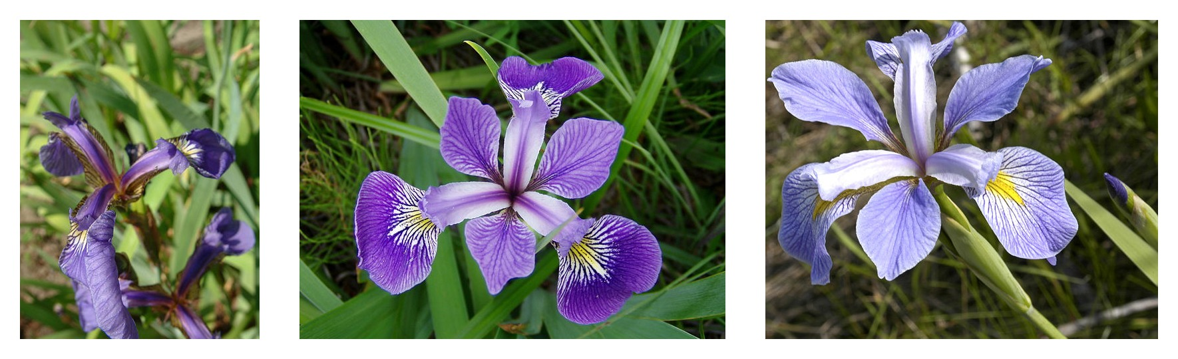
Example
Predict iris genus from measurements of sepal length, sepal width, petal length, and petal width.
Database of labeled data available. Each entry of the form [measurements, genus]
Use some for training (the training set)
Use some for testing (the test set)

Slide 31
Example
Go to:
https://www.tensorflow.org/tutorials/eager/custom_training_walkthrough#configure_imports_and_eager_execution
Questions:
What happens if you add another hidden layer?
What happens if you increase the learning rate?

Slide 32
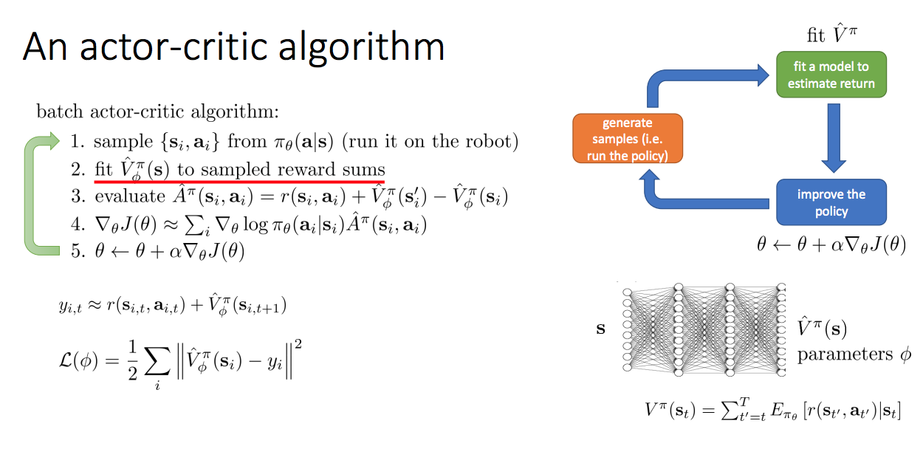
Reinforcement Learning with Neural Networks
V is the “value function”
A is the “advantage function”

Slide 33
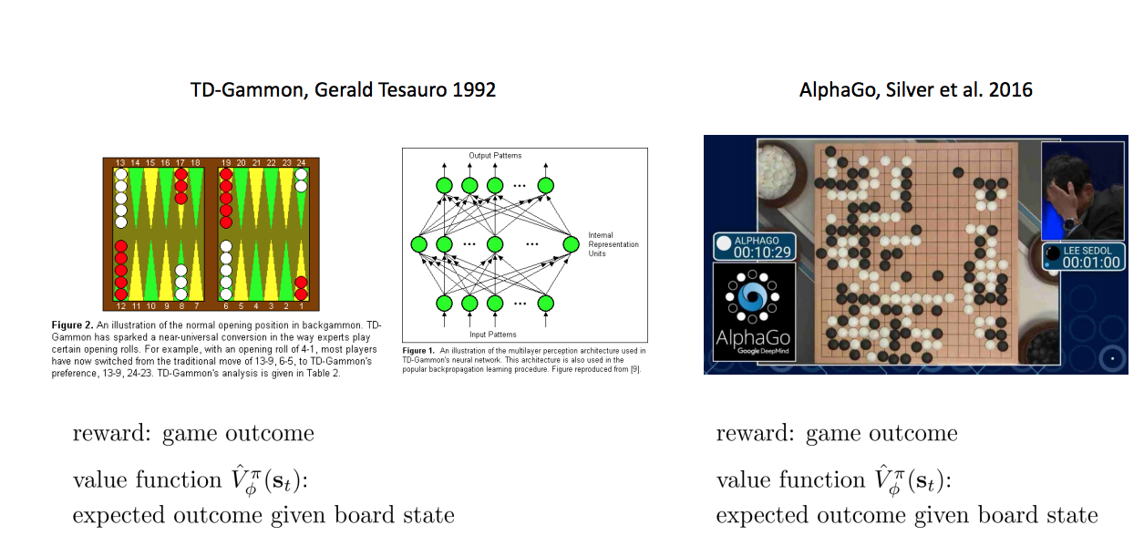
Examples

Slide 34
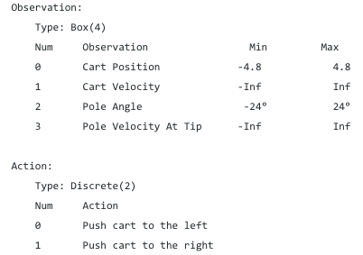
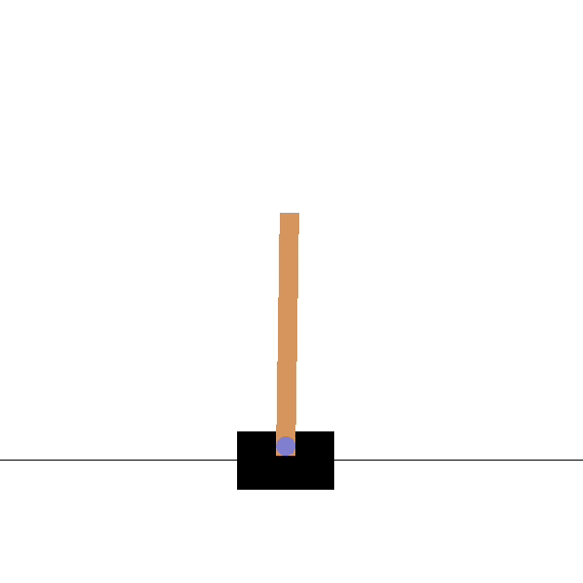
Control Example
Reward +1 every time step the pole remains upright.
Limit 15 degrees or 2.4 units from center
https://towardsdatascience.com/cartpole-introduction-to-reinforcement-learning-ed0eb5b58288
Uses “Open AI Gym”: https://gym.openai.com/

Slide 35
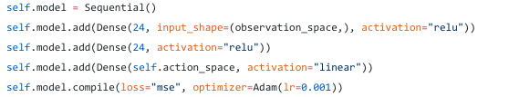
Deep Q-Learning
Cost-to-go Neural Network
Experience Replay
Keep a memory of experiences and replay them to continually improve the cost-to-go network
Randomly sample the memory to get state/action/reward triples, and add NN’s estimate of remaining cost to go

Slide 36
Python and Results
Go to
https://colab.research.google.com/drive/1eecEBoVNayubDFNxQuJHYtmHvgbUhJwP#scrollTo=Rq4NAPCkzO2z

Slide 37
The State of Machine Learning

Slide 38
Discussion
ML doesn’t work for everything.
What applications are best?
What is the relationship between classical control and machine learning?
When would you *not* use machine learning?
ML does better than people at driving, video games, stock market trading, etc.
What will happen to human labor when ML is better than us at just about everything?

